Slide 1

Note: The data and information in this document is reflective of a hypothetical situation and client. This document is to be used for KPMG Virtual Internship purposes only.
Sprocket Central Pty Ltd
Data analytics approach
[Division Name] - [Engagement Manager], [Senior Consultant], [Junior Consultant]

Slide 2
Note: The data and information in this document is reflective of a hypothetical situation and client. This document is to be used for KPMG Virtual Internship purposes only.
Agenda
Introduction
Data Exploration
Model Development
Interpretation

Slide 3
Note: The data and information in this document is reflective of a hypothetical situation and client. This document is to be used for KPMG Virtual Internship purposes only.
Introduction
This PowerPoint presentation outlines the approach which we will be taking, to Explore the Data, Develop the Model and Interpret the Data.

Slide 4
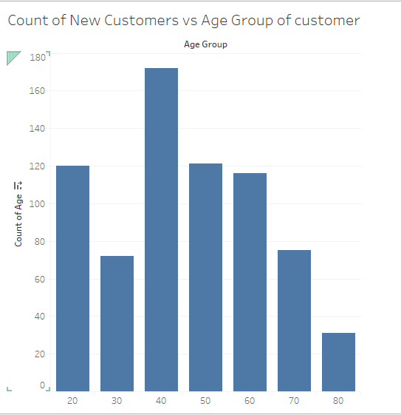
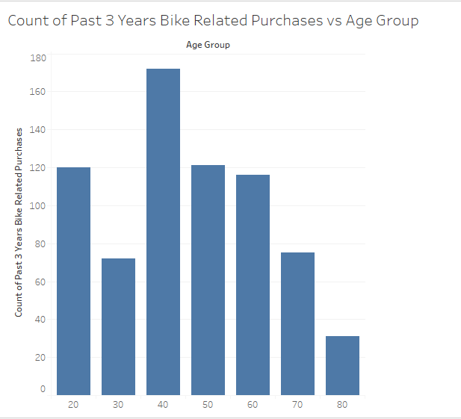
Note: The data and information in this document is reflective of a hypothetical situation and client. This document is to be used for KPMG Virtual Internship purposes only.
Data Exploration: Age Distribution & Bike Purchases
The age group of 40-49 has the highest number of new customers, followed by 50-59 & 20-29.
Age group of 80-90 has the least number of new customers due to old age.
Data shows age group 40-49 has high count in terms of bike related purchases in last 3 years.
Age group 20-29, 40-49, 50-59 & 60-69 should be the major target audience for marketing and advertising because they have the highest number of Bike related purchases in the last three years.

Slide 5
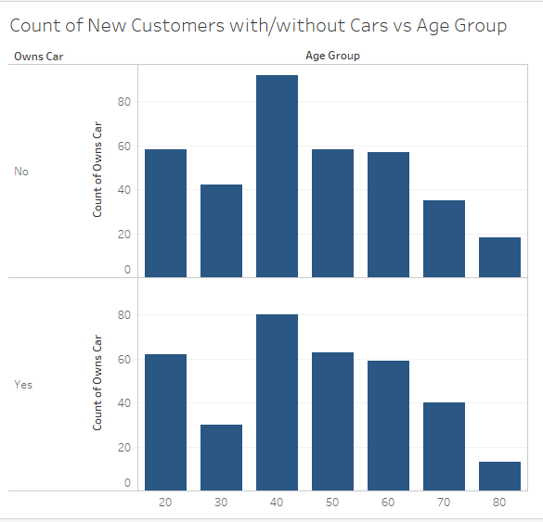
Note: The data and information in this document is reflective of a hypothetical situation and client. This document is to be used for KPMG Virtual Internship purposes only.
Data Exploration: Cars Owned by New Customers
The age group of 40-49 has the highest number of new customers without cars, followed by age group 20-29, 50-59 & 60-69 .
Data shows age group 40-49 has the highest number of new customers without cars and the number of customers without cars is greater than the number of customers with cars .
Age group 20-29, 40-49, 50-59 & 60-69 should be the major target audience for marketing and advertising because, they have the highest number of new customers without cars, which tells us there is a potential market in those age groups.

Slide 6
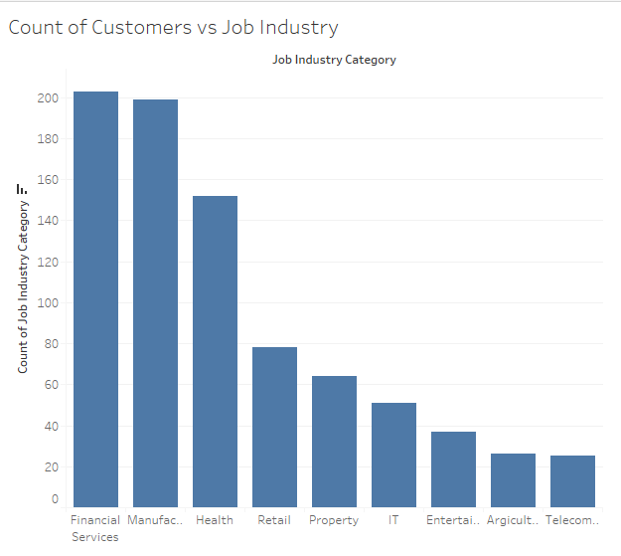
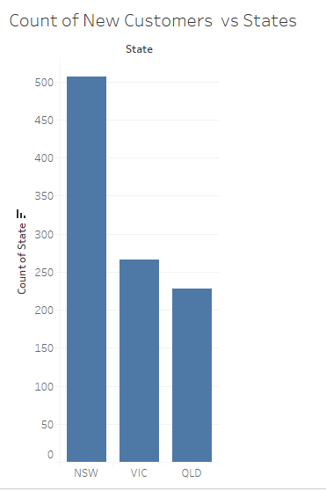
Note: The data and information in this document is reflective of a hypothetical situation and client. This document is to be used for KPMG Virtual Internship purposes only.
Data Exploration: New Customers in Job Industries and States
Financial Services, Manufacturing and Health Industry have the highest number of new customers.
New South Wales(NSW) has the highest number of customers out of the three states which means, it is the state with most prospect.

Slide 7
Note: The data and information in this document is reflective of a hypothetical situation and client. This document is to be used for KPMG Virtual Internship purposes only.
Model Development
Cleaned data by removing duplicates and blanks also, made sure data stayed consistent.
Converted D.O.B to age and then categorized their age to age groups.
Compared the age groups with the number of new customers, 3 years bike related purchases and Car owned by the New Customers.
Compared the number of new customers to the Job Industry and the State where they currently live in.
These processes were carried out to get insights from the data and also to ensure the Model aligns with the Business Task.l

Slide 8
Note: The data and information in this document is reflective of a hypothetical situation and client. This document is to be used for KPMG Virtual Internship purposes only.
Intepretation
Targeting High Value Customers for Marketing and Resource Allocation
New Customers Aged 40-49
New Customers currently living in New South Wales
New Customers working in Financial Services, Manufacturing and Health

Slide 9
Note: The data and information in this document is reflective of a hypothetical situation and client. This document is to be used for KPMG Virtual Internship purposes only.
THANK YOU

